Slide 1

WinCE eBoot & Kernel Porting
연구 2팀 김 득 중
2006/06/16

Slide 2
CONTENTS
OVERVIEW
BOOT LOADER
KERNEL
HOWTO PORTING
DEBUGGING AND TESTING

Slide 3
OVERVIEW-1
WinCE Structure
APPLICATION
COREDLL.DLL
NK.EXE
GWES.EXE
FILESYS.EXE
DEVICE.EXE
SERVICES.EXE
OAL
Touch
Display
Key board
Object Store
ROM FS
Storage Manager
Block Device
Serial
Custom
FTP
HTTP
TELNET
RAM
ROM FLASH
HARDWARE
Timer
INTC
Serial
USB
PCCard
…
CPU

Slide 4
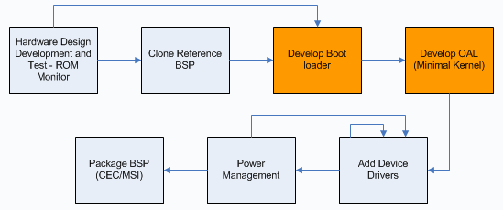
OVERVIEW-2
BSP Develop Process

Slide 5
BOOT LOADER
Startup Sequence
Boot Loader Startup Sequence
Startup()
RAM Setting, Interrupt/WDT Disable
KernelStart()
eBoot code copy to RAM
Main()
BootloaderMain()
OEMDebugInit()
Serial Initialize
OEMPlatformInit()
eBoot menu
OEMPreDownload()
Ethernet Initialize
DownLoad Occurs
OEMLaunch()
Jump to kernel

Slide 6
KERNEL
Startup Sequence
Kernel Startup Sequence
Startup()
RAM Setting, Interrupt/WDT Disable
KernelStart()
OEMInitDebugSerial()
Serial Initialize
OEMInit()
Ethernet Initialize
ARMInit()
KernelInit()
HeapInit()
Heap.c
InitMemoryPool()
Physmem.c
FirstSchedule()
ProcInit()
Schedule.c
SchedInit()
Schedule.c
SystemStartupFunc()

Slide 7
HOWTO PORTING
Boot Loader Development
Kernel Development
Boot Loader Porting List
Kernel Porting List
Configuration File

Slide 8
BOOT LOADER DEVELOPMENT
Create a sources file and makefile file
Build first boot loader (.exe) file
Verify that the boot loader

Slide 9
KERNEL DEVELOPMENT
Implement the function for the OAL
Create a sources file and a makefile
Build the kernel executable image
Verify Nk.bin image

Slide 10
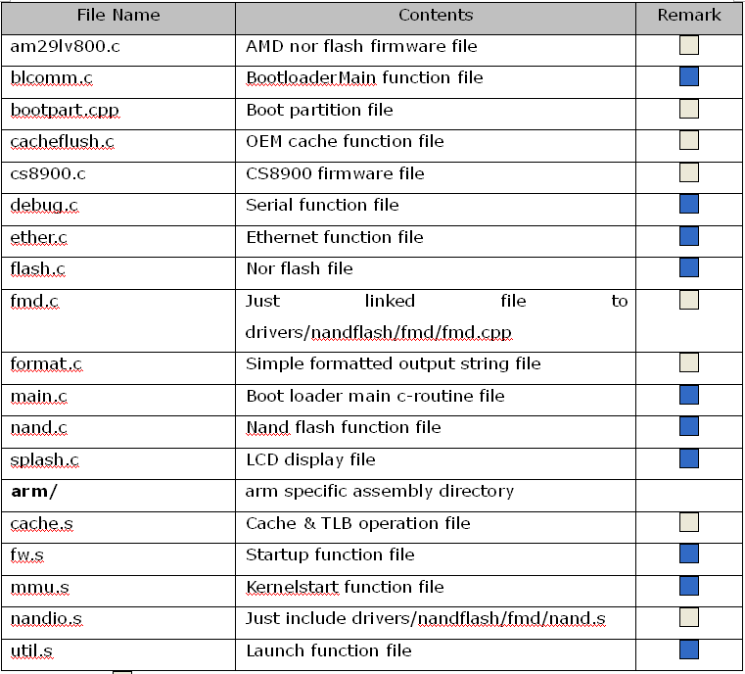

BOOT LOADER PORTING LIST

Slide 11
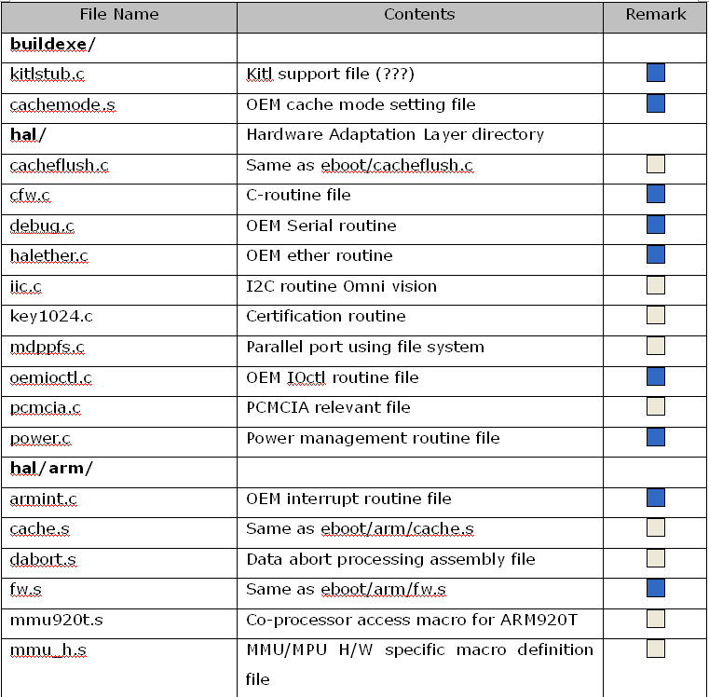
KERNEL PORTING LIST-1

Slide 12
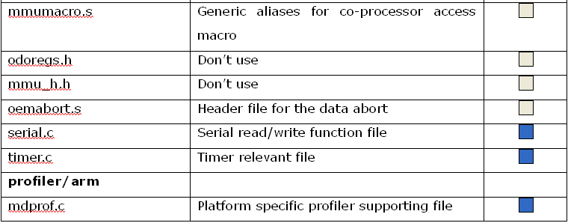
KERNEL PORTING LIST-2

Slide 13
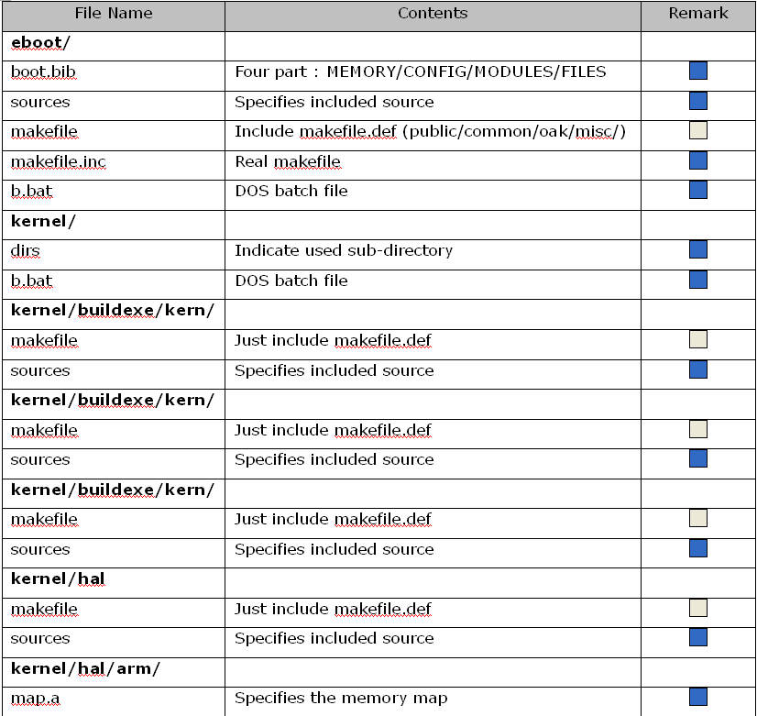
CONFIGURATION FILE-1

Slide 14
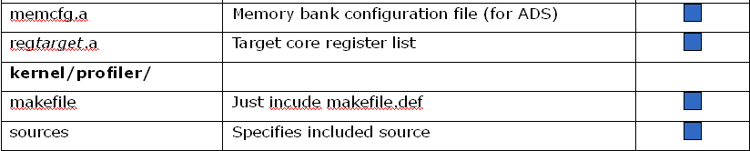
CONFIGURATION FILE-2

Slide 15
DEBUGGING AND TESTING
Debugging Resource Overview
Boot Loader
Kernel

Slide 16
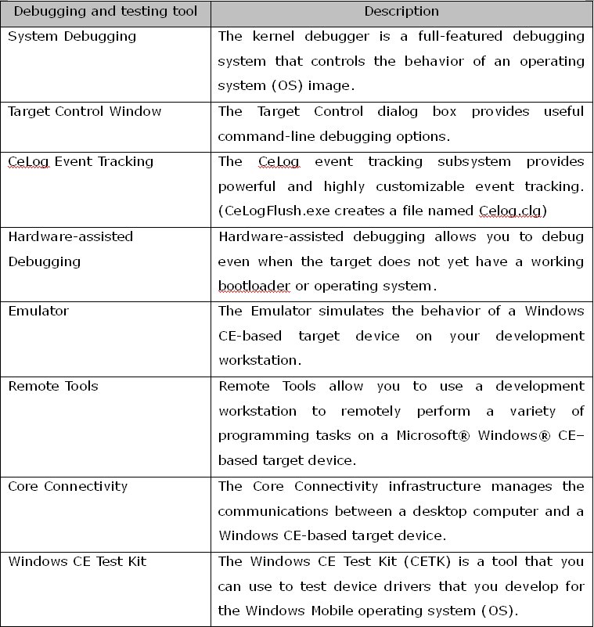
DEBUGGING RESOURCE OVERVIEW

Slide 17
BOOT LOADER
Test boot loader communications
Verify that the boot loader can use Platform Builder to download a .bin file
To verify the RAM or flash memory

Slide 18
KERNEL
Hardware-assisted Debugging
System Debugging
Remote Tools
Emulator

Slide 19
APPENDIX
Reference (MSDN Site)
  WinCE5.0 BSP, Boot Loader, and Kernel Startup Sequence
  How to Develop a Boot Loader
  How to Develop an OAL(OEM Adaptation Layer)
  Debugging and Testing

Slide 20
Thank You!

